Slide 1
Linear Algebra

Slide 2
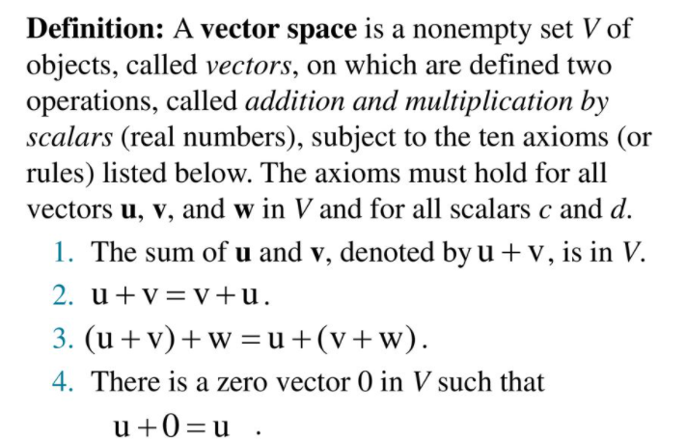
Vector space

Slide 3
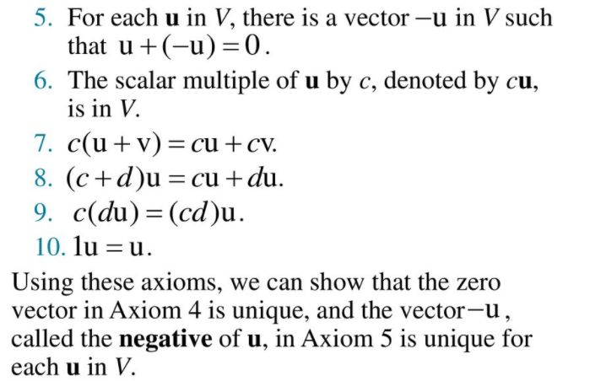

Slide 4
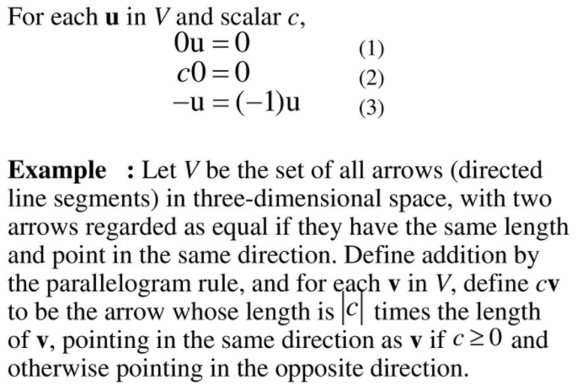

Slide 5
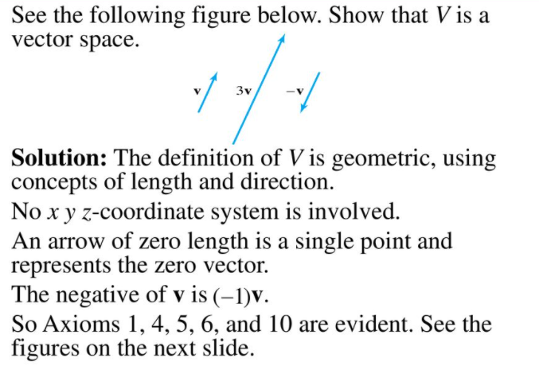

Slide 6
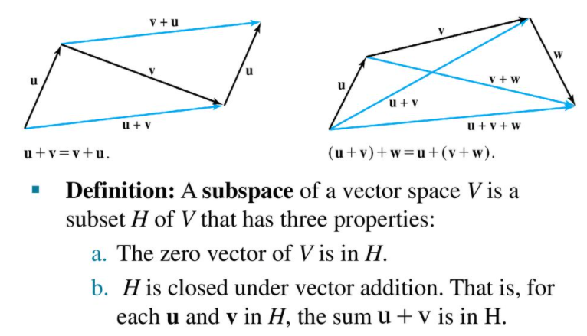

Slide 7
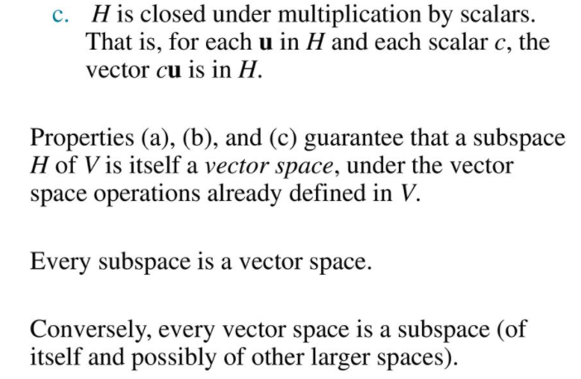

Slide 8
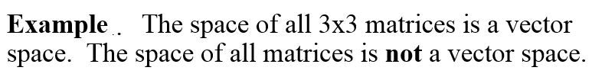
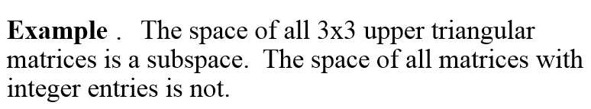

Slide 9
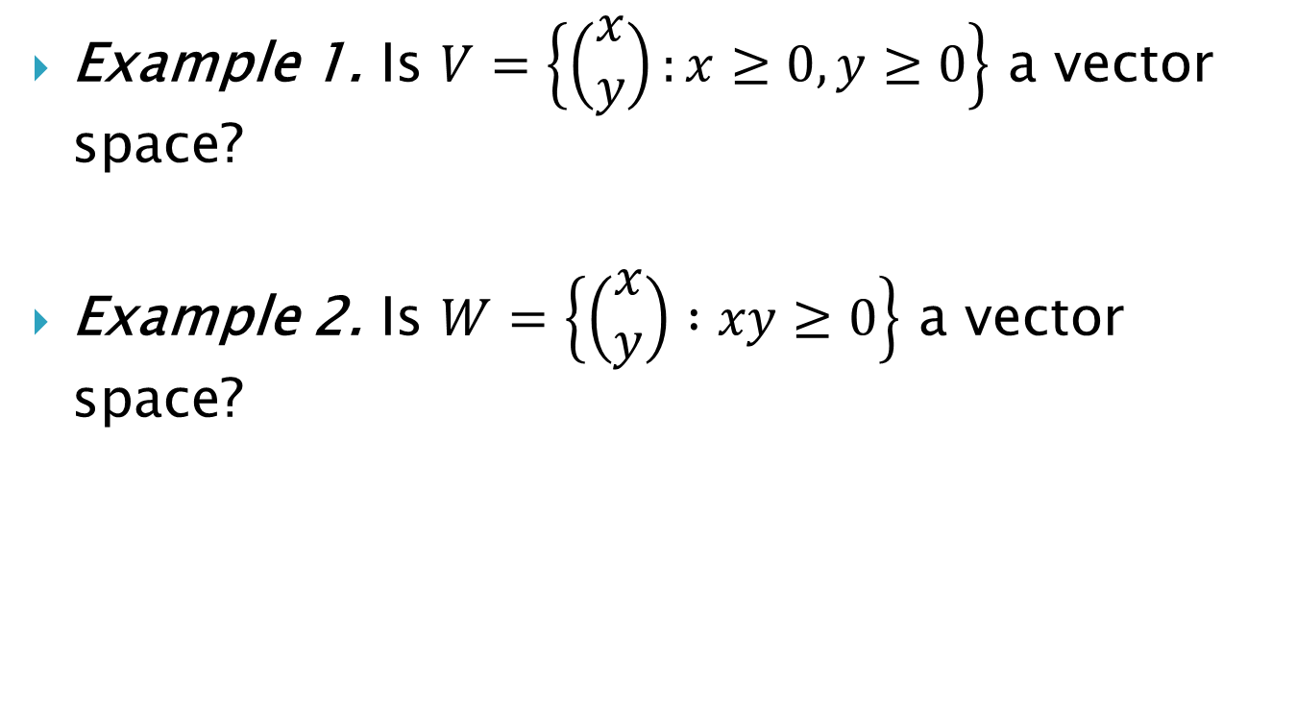
Example 1. Is $V=\left\{\left(\begin{matrix}x \\ y\end{matrix}\right):x≥0, y≥0\right\}$ a vector space?
Example 2. Is $W=\left\{\left(\begin{matrix}x \\ y\end{matrix}\right) :xy≥0\right\}$ a vector space?

Slide 10
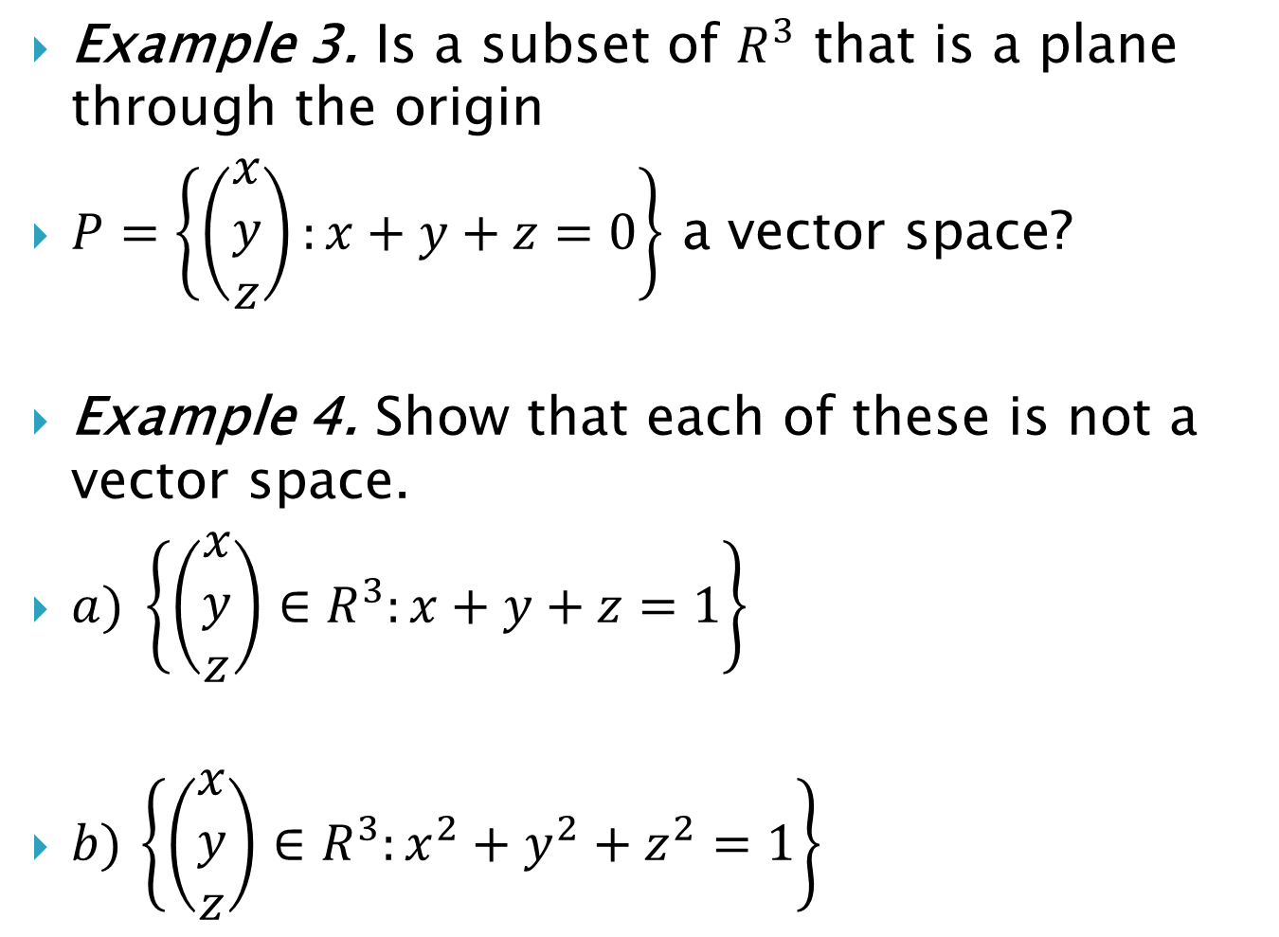
Example 3. Is a subset of $R^{3}$ that is a plane through the origin
$P=\left\{\left(\begin{matrix}x \\ y \\ z\end{matrix}\right):x+y+z=0\right\}$ a vector space?
Example 4. Show that each of these is not a vector space.
$a) \left\{\left(\begin{matrix}x \\ y \\ z\end{matrix}\right)∈R^{3}:x+y+z=1\right\}$
$b)$ $\left\{\left(\begin{matrix}x \\ y \\ z\end{matrix}\right)∈R^{3}:x^{2}+y^{2}+z^{2}=1\right\}$

Slide 11
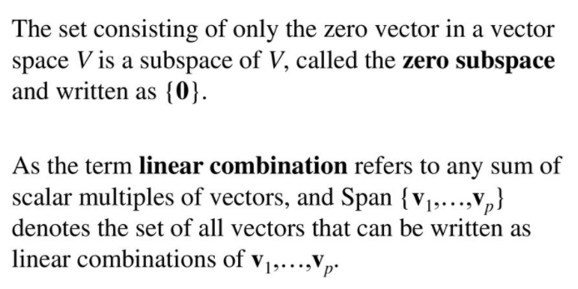
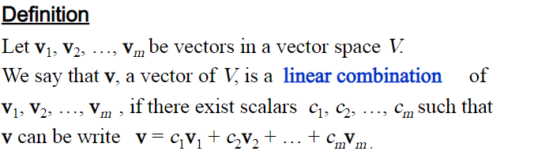

Slide 12
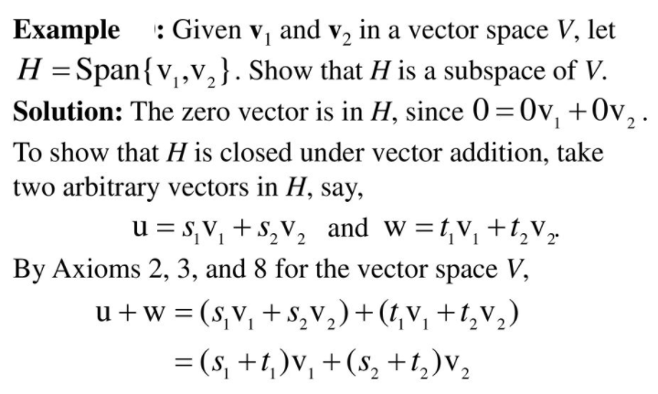

Slide 13
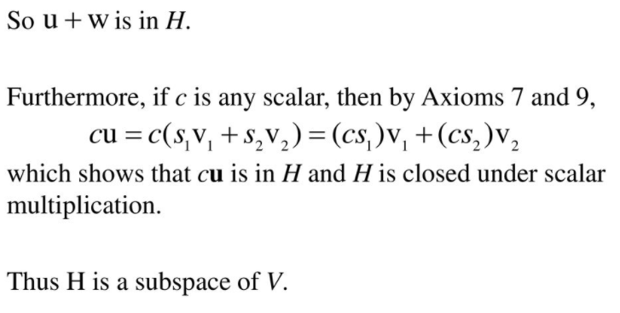

Slide 14
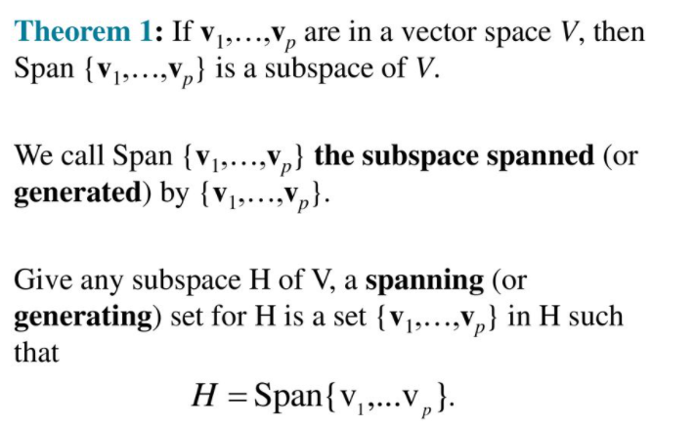

Slide 15
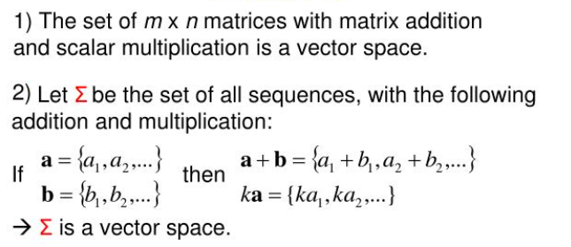
Examples of vector spaces

Slide 16
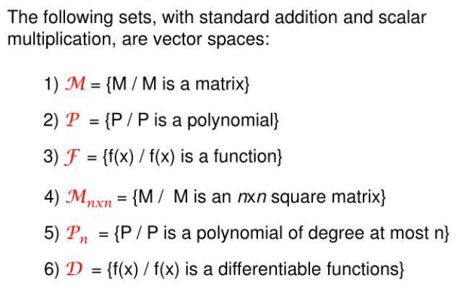

Slide 17
